Slide 1
Unit 6
MANAGEMENT INFORMATION SYSTEMS 8/E
Raymond McLeod, Jr. and George Schell
The Accounting
Information System
&
The Management
Information System
1-<number>
Copyright 2001 Prentice-Hall, Inc.
Notes:
1

Slide 2
Chapter 11
MANAGEMENT INFORMATION SYSTEMS 8/E
Raymond McLeod, Jr. and George Schell
The Accounting
Information System
11-<number>
Copyright 2001 Prentice-Hall, Inc.
Notes:
1

Slide 3
What is Data Processing?
Manipulation or transformation of symbols for the purpose of increasing their usefulness.
Data processing (DP) and transaction processing (TP) are often used interchangeably.
Applied to business data
11-<number>
Notes:
2

Slide 4
Accounting Information
Systems (AIS)
Gathers data describing a firm’s activity
Transforms data into information
Makes information available to users inside and outside the firm
11-<number>

Slide 5
A Model of an Accounting Information System
Environment
Information
Management
Data
processing
software
Data
Database
Accounting
Information
System
Input
physical
resources
Output
physical
resources
Transform
Environment
11-<number>
Notes:
3

Slide 6
Data Processing Tasks
1. Gather data
  Each transaction is documented
  What happened?
  When did it happen?
  How much (volume, value)?
  Transactions describe
11-<number>
Notes:
5

Slide 7
Data Processing Tasks [cont.]
2. Manipulate data
  Classify (use codes)
  Sort
  Calculate
  Summarize
11-<number>
Notes:
6

Slide 8
Data Processing Tasks [cont.]
  3. Store data
    Describes each transaction
    Represents most of the database
11-<number>
Notes:
7

Slide 9
Data Processing Tasks [cont.]
4. Document preparation
  Triggers
    By an action
    By a time schedule
  Hardcopy or on-screen
11-<number>
Notes:
8

Slide 10
Characteristics of the AIS
Performs necessary tasks
Standard procedures
Detailed data
Historical focus
Provides minimal problem-solving information
11-<number>
Notes:
9

Slide 11
Sample AIS
The Distribution System
Users
  Manufacturers
  Wholesalers
  Retailers
General in nature
Used in many different types of firms
  Retailers
  Manufacturing
  Service
11-<number>
Notes:
10

Slide 12
DFDs
Data flow diagram
  Document a system in a hierarchical manner
  Data flows, processes, environmental elements
Context level is overall system within environment
Leveled and Balanced DFDs
11-<number>

Slide 13
A Context Diagram of the
Distribution System
Customers
Sales orders
Commitments
Purchases orders
Rejected
sales
order
notices
Shipments
Invoices
Supplier invoices
Suppliers
Distribution
system
Supplier statements
Statements
Payments by customers
Payments to suppliers
Income
Balance
statement
sheet
Stock
Materials
Budget
reports
stockroom
Management
Other reports
11-<number>

Slide 14
Sales Orders
Customers
A Figure 0 Diagram of the
Distribution System
Rejected sales order notices
Invoices
Statements
1.
Fill
Orders
Payments by customers
Receivables ledger data
Inventory ledger data
Purchasing data
Commitments
Received
items
3.
Maintain
general
ledger
Payables ledger data
2.
Order
replenish-
ment
stock
Purchase Orders
Other reports
Shipments
Suppliers
Budget reports
Supplier invoices
Income
statement
Balance
sheet
Supplier statements
Payments to suppliers
Management
Materials
stockroom
Stock
11-<number>

Slide 15
A Figure 1 Diagram of the
Systems that Fill Customer
Orders
Sales orders
Customers
Rejected sales order notices
Accepted orders
1.1
Order
Entry
Filled items
Completed
orders
1.2
Inventory
Payments by customers
Statements
Invoices
1.3
Billing
Billed orders
1.4
Accounts
receivable
Purchasing data
Receivables ledger data
Inventory
ledger data
2
Received
items
3
3
2
11-<number>

Slide 16
A Figure 2 Diagram of the Systems that Order Replenishment Stock
Purchasing data
Commitments
1
2.1
Purchasing
Purchase orders
Issued purchase
order data
Filled
purchase
orders
Shipments
Suppliers
Received items
1
2.2
Receiving
Stock
Materials
stockroom
Received
purchases
Supplier invoices
Incurred obligations
2.3
Accounts
payable
Supplier statements
Payable
ledger data
Payments to suppliers
3
11-<number>

Slide 17
A Figure 3 Diagram of the Systems That
Perform General Ledger Processes
1
Receivables ledger data
3.1
Update
general
ledger
General ledger records
1
Inventory ledger data
Updated general ledger records
2
Payables ledger data
Management report data
General
ledger
Other reports
3.2
Prepare
management
reports
Budget reports
Balance sheet
Income statement
Management
11-<number>

Slide 18
Fill Customer Orders
Order entry
  Sales order form
Inventory
  Process sales
  Process receipts
  Feed general ledger
11-<number>
Notes:
16

Slide 19
A Figure 1.1 Diagram of the Order Entry System
Customers
Sales orders
Edit rejects
Sales order
edit ejects
Edited
orders
Rejected
sales order
notices
1.1.1
Edit order data
Customer
credit file
1.1.2
Computer
credit
check
Credit data
Edited and checked orders
Sales order
credit rejects
Accepted
orders
Credit Rejects
1.1.3
Log in
orders
Order data
1.2
1.1.4
Mark
filled
orders
Date filed
Completed orders
Order log
1.3
11-<number>

Slide 20
A Figure 1.2 Diagram of the Inventory System
1.1
Accepted
orders
1.2.1
Check
the
balance
on hand
1.2.3
Add
received
items
Received items
Item records
Inventory
file additions
2
Backorder
records
Inventory
file
Backorder
file
Items
available
Updated item
records
Inventory
ledger data
Inventory
records
1.2.2
Check
the
reorder
point
1.2.4
Provide
general
ledger
data
3
Filled items
Purchasing data
1.3
2
11-<number>

Slide 21
Billing
Invoice
  Note:
    1. Customer data
    2. Item data
11-<number>
Notes:
19

Slide 22
A Figure 1.3 Diagram of the
Billing System
1.2
Filled
items
1.3.1
Obtain
customer
data
Customer data
Customer
file
Invoice
data
1.3.2
Prepare
invoices
Customers
Invoices
Billed orders
1.4
Completed
orders
1.1
11-<number>

Slide 23
Accounts Receivable
Four separate triggers
  Today's sales
  Today's payments
  Time to send statements
  Need to provide general ledger data
11-<number>
Notes:
21

Slide 24
Billed orders
A Figure 1.4 Diagram of the
Accounts Receivable System
1.3
1.4.1
Add new
receivables
New receivables
Receivables records
1.4.4
Provide
general
ledger data
Accounts
receivable
file
Statement records
Receivables
records
to delete
Receivables
ledger data
3
1.4.3
Prepare
statements
1.4.2
Delete paid
receivables
Statements
Paid
receivables
records
Paid
receivables
file
Payments by
customers
Customers
11-<number>

Slide 25
Order Replenishment Stock
Purchasing
  Emerging technologies
    EDI
    ISDN
  Purchase order
11-<number>
Notes:
23

Slide 26
A Figure 2.1 Diagram of the Purchasing System
Purchasing data
2.1.1
Select
suppliers
Past performance data
Supplier
file
1
Inventory
and supplier data
Purchase order data
2.1.2
Obtain verbal
commitments
Commitments
Issued purchase
order data
2.2
Purchase Orders
Suppliers
2.1.3
Prepare
purchase
orders
2.3
Purchase
order records
Incurred
Obligations
Outstanding
purchase
order files
Purchase records
to close out
Purchase
Order
history file
2.1.4
Close out
purchase
orders
Filled purchase Orders
Removed purchase
order records
2.2
11-<number>

Slide 27
A Figure 2.2 Diagram of the Receiving System
2.1
Issued
purchase
order
data
Purchased
item data
Suppliers
Purchased
items file
Shipments
Receipt
information
2.2.1
process
receipts
Stocks
Received items
Materials
stockroom
2.2.1
Notify
other
systems
1
Filled purchase orders
2.1
Received purchases
11-<number>
2.3

Slide 28
Accounts Payable
The firm pays suppliers when:
  1. Stock was ordered (P.O. file copy)
  2. Stock was received (Received purchases file)
  3. Invoice
11-<number>
Notes:
26

Slide 29
A Figure 2.3 Diagram of the Accounts Payable System
Incurred
Obligations
2.1
Payables
Records
Payables Ledger
Data
2.3.1
Set up
supplier
payables
records
New Payables
data
Accounts
payable
file
2.3.4
Provide
general
ledger
data
3
Received
Purchases
Paid Payables Records
Payables
Records to
delete
2.2
Paid
payables
file
Received
purchases
file
2.3.3
Delete paid
payables
Supplier Invoices
Invoice and
statement
file
Receipt
Data
Payment
data
Supplier
statements
Paid Supplier
Data
2.3.2
Make
supplier
payments
Invoice Data
Suppliers
Payments to Suppliers
11-<number>

Slide 30
AIS is the Foundation System
The AIS must be implemented first
  MIS
  DSS
  ES
Depends on a well-designed AIS
11-<number>
Notes:
28

Slide 31
Summary
AIS maintains financial records of the firm
Data processing components
  Data gathering
  Data manipulation
  Data storage
  Document preparation
AIS Subsystems
AIS contributes to problem solving
11-<number>

Slide 32
Chapter 12
MANAGEMENT INFORMATION SYSTEMS 8/E
Raymond McLeod, Jr. and George Schell
The
Management
Information System
12-<number>
Copyright 2001 Prentice-Hall, Inc.
Notes:
1

Slide 33
MIS Definition
A computer-based system that makes information available to users with similar needs.
  Users are typically comprise a formal organizational entity
  Describes what has happened in the past
12-<number>
Notes:
2

Slide 34
Early MIS Efforts
Popular in business by the mid 1960s
Punched card and keydriven machines were used only for data processing
The first computers were applied the same way
Only a few computer literate people in the firms
Managers became aware of computer’s processes and power
12-<number>
Notes:
3

Slide 35
MIS is an Organizational Resource
Information
  Past, present, future
  Periodic reports, special reports, simulations
Similar needs
  Functional area
  Management level
  Managers and nonmanagers
12-<number>
Notes:
4

Slide 36
An MIS Model
Database
  AIS data and information
  Environmental data and information
Interorganizational information systems (IOS)
  Firms band together with other organizations such as suppliers
12-<number>
Notes:
5

Slide 37
An MIS Model
Environment
Data Information
Organizational
problem
solvers
Report writing
software
Mathematical
models
Database
Management
Information
System
Environment
12-<number>
Notes:
6

Slide 38
Organizational Information Systems
Executive
Information
System
(EIS)
Marketing
information
system
Manufacturing
information
system
Financial
information
system
Human resource
information
system
12-<number>
Notes:
7

Slide 39
Functional Information Systems
MIS tailored to meet users’ needs for information concerning functional areas
  Manufacturing
  HRIS
  Others
Executive information systems (EIS)
Enterprise information system
  Pulls functional ISs together
  Enterprise resource planning (ERP)

Slide 40
Report Writing Software
Periodic and special reports may look the same
Difference is in what triggers the report
  Periodic report
    Produced on a schedule
  Special report
    Produced when something out of the ordinary occurs
12-<number>

Slide 41
Incorporating Management by Exception
Prepare the report only when exceptions occur
Use the report sequence to highlight exceptions
Group exceptions together
Show the variance from the norm
12-<number>

Slide 42
An Overtime Earnings Report
OVERTIME EARNINGS REPORT
FOR WEEK ENDING AUGUST 19
OVERTIME EARNINGS
Department No. Department Name Current Month Year-to-Date
16-10 Receiving $ 2,305.00 $ 5,319.20
16-11 Inspection $ 1,025.60 $ 4,386.12
16-12 Materials Handling $ 3,392.50 $12,629.00
16-13 Tooling $ 78.00 $ 1,049.00
16-14 Assembly $ 0.00 $ 792.80
16-15 Plating $ 3,504.90 $12,635.20
16-16 Shipping $ 5,219.16 $18,294.16
TOTALS $15,525.16 $55,105.48
12-<number>

Slide 43
SALES BY PRODUCT
FOR THE MONTH OF JUNE
  PRODUCT PRODUCT CURRENT MONTH YEAR-TO-DATE
  NUMBER NAME SALES SALES
  129875 GASKET CENTER CASE $ 5,090.23 $ 31,764.00
  087235 MAINSHAFT 4,760.01 29,329.45
  118320 1ST MOTION SHAFT 1,789.45 28,243.59
  250067 OIL SEAL REAR 11,560.24 23,450.07
  228203 LAYGEAR 8,369.34 14,709.03
  576000 HUB 5TH .00 13,623.68
  516012 SHIFT FORK 1-2 450.95 12,634.44
  090407 SYNCHRO RING 2ND 2,243.27 9,963.58
  282130 BUSH SHIFT LEVER .00 490.00
  576301 OIL SLINGER .00 11.50
12-<number>

Slide 44
AGED ACCOUNTS RECEIVABLE REPORT
AS OF MAY 31
  -----------------------------------------------------------------
  ----CUSTOMER-------- CURRENT 30-60 60-90 OVER 90 TOTAL
  NUMBER NAME AMOUNT DAYS DAYS DAYS AMOUNT
  -----------------------------------------------------------------
  51212 KELLY & MARLEY INC 1,003.10 20.26 1023.26
  51221 KENNEDY ELECTRIC 181.34 181.34
  52472 KENYON MACHINERY 443.10 443.10
  53204 KEPNER DANA CO 153.26 114.14 11.12 278.52
  54233 KERITE CO 367.94 101.74 469.68
  54574 KEYMAN ASSOCIATES 432.71 431.71
  55081 KIMBULIANS 24.12 122.81 146.93
  55430 KIRSCH CO 26.30 26.30
  60245 LEBEN DRILLING 1.10 476.93 174.96 652.39
  60772 LEEMONT INC 35.87 35.95 71.82
12-<number>

Slide 45
SALES BY SALESPERSON REPORT
FOR THE MONTH ENDING MARCH 31
  SALESPERSON CURRENT-MONTH YEAR-TO-DATE
  ----------- ---------------------- ----------------------
  NO. NAME QUOTA ACTUAL VARIANCE QUOTA ACTUAL VARIANCE
  0120 JOHN NELSON 1200 1083 -117 3600 3505 -95
  10469 LYNN SHERRY 1000 1162 +162 3000 3320 +320
  19261 DARVIN UPSHAW 800 1090 +290 2400 2510 +110
  20234 JANIE EVANS 1500 1305 -195 4500 4110 -390
  61604 TRAVIS BURKE 2000 2333 +333 6000 6712 +712
  62083 CATHY HAGER 1000 990 -10 3000 2319 -681
  63049 STEVE JENNER 1100 1250 +150 3300 2416 -884
  64040 SAM MOSELY 1050 985 -65 3150 3020 -130
  TOTALS 9650 10198 548 28950 27912 -1028
12-<number>

Slide 46
Modeling
Models are abstractions
Models may be:
  Physical
  Narrative
  Graphic
  Mathematical
12-<number>

Slide 47
Mathematical Modeling
Most important to MIS users
Three dimensions
  Influence of time
  Degree of uncertainty
  Ability to optimize
12-<number>

Slide 48
Mathematical Model Types
Static
  Does not include time
  Like a snapshot
Dynamic
  Includes time
  Like a motion picture
12-<number>

Slide 49
Mathematical Model Types (cont.)
Probabilistic
  Includes probabilities of events occuring
  0.00 to 1.00
Deterministic
  Events are certain
  Not random
12-<number>

Slide 50
Mathematical Model Types (cont.)
Optimizing
  Selects best solution
  Requires structured problems
Suboptimizing
  Also called satisficing
  Model identifies outcomes for manager to select among
12-<number>

Slide 51
Simulation
Use of a model is called simulation
Scenario
  Conditions that influence the simulation
  Scenario data elements
Decision variables
  Input values
Output format varies
12-<number>

Slide 52
Simulation (cont.)
Simulation Technique
  Single scenario for optimizing model
  What-if game for suboptimizing models
  Change only single decision variable per run
  Systematically discover answers to problems
Output format
  Include both decision variables and outcomes on same report
12-<number>

Slide 53
Modeling Example
Use model to simulate the effect of:
  Price of product
  Amount of plant investment necessary to provide sufficient capacity
  Amount to invest in marketing activity
  Amount to invest in R & D
Enter model input
Review model outputs
12-<number>

Slide 54
More on Modeling
Advantages
  Can be a learning experience
  Speed allows consideration of more options
  Provides predictive power
  Less expensive than trial-and-error method
Disadvantages
  Difficult to model a business system
  High degree of mathematical skills required
12-<number>

Slide 55
INVENTORY PLANNING MODEL
OCTOBER 11
  SCENARIO:
  BEGINNING BALANCE: 200
  DAILY SALES UNITS: 20
  DECISIONS:
  0RDER QUANTITY: 100
  REORDER POINT: 175
  LEAD TIME: 3
  RESULTS:
  BEGINNING ENDING ORDER RECEIPT
  DAY BALANCE RECEIPTS SALES BALANCE QUANTITY DUE DATE
  1 200 20 180 25 5
  2 180 50 20 160
  3 160 20 140
12-<number>

Slide 56
Graphic Output
Use graphics to
  present a quick summary
  detect trends over time
  forecast activities
  seek relatively simple impressions from a large volume of data
12-<number>
Notes:
14

Slide 57
Graphical Output
Reports and model outputs can be produced in tabular or graphical form
Spreadsheets have encouraged the use of graphics
Can improve decision making capability
12-<number>

Slide 58
Which Graphs to Use
Line or bar charts are best to summarize data
Grouped line or bar charts show trends over time
Grouped bar charts are better for representing parts of a whole
Compare variables using horizontal, not vertical, bars
Use single line or bar charts to compare data points
12-<number>

Slide 59
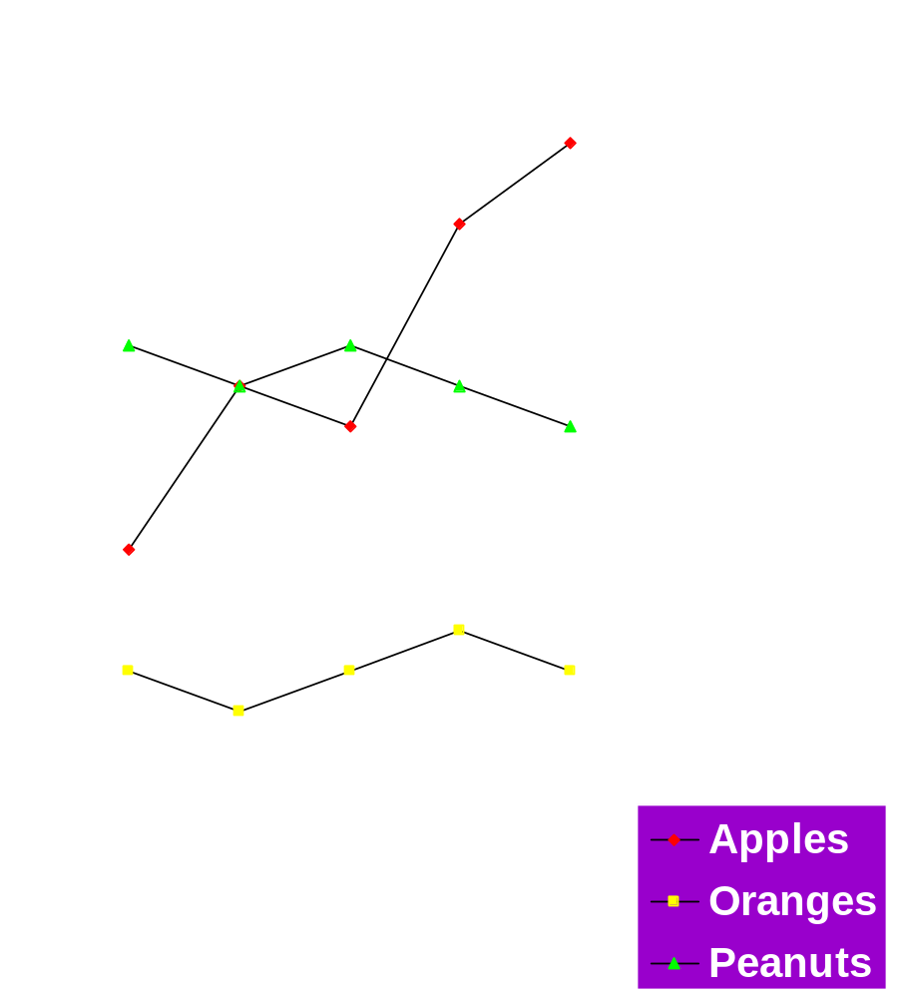
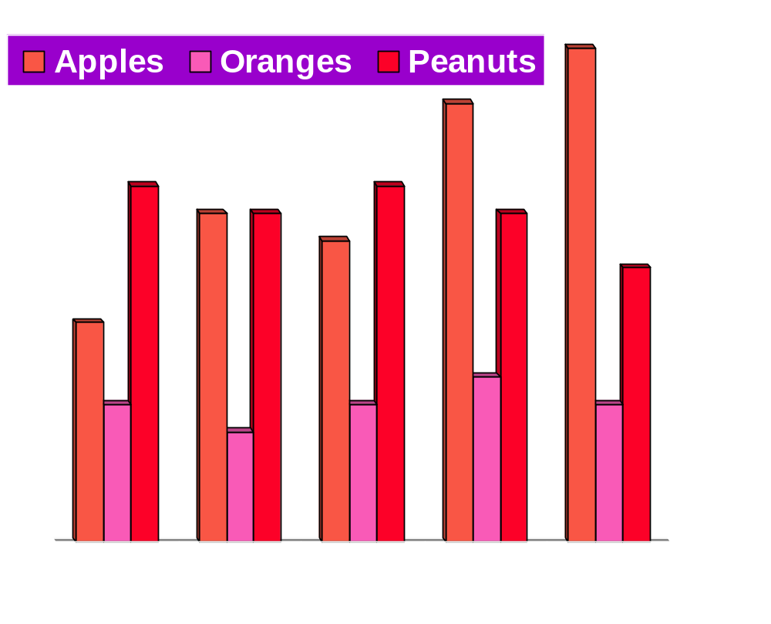
GROUPED/MULTIPLE LINE CHART
GROUPED BAR CHART
Sales Revenue
Sales Revenue
Years
(c)
Years
(a)
12-<number>

Slide 60
Segmented Line Chart
200
150
Dollars in Millions
100
50
0
1980
1981
1982
1983
1984
Years
(b)
Legend:
Apples
Oranges
Peanuts
12-<number>

Slide 61
Segmented/Divided Bar Chart
Sales Revenue
200
150
100
Dollars in Millions
50
0
1980
1981
1982
1983
1984
Legend:
Apples
Oranges
Peanuts
Years
(d)
12-<number>

Slide 62
Human Factors Consideration
Behavioral influences can affect employees in their computer-related tasks
Fear
  Replacement of people by computers
  Computer systems tailored to organizations, not individuals
  Managers and line workers are affected
12-<number>

Slide 63
Minimizing Fear
Use computer as a means of achieving job enhancement
Use formal communications to keep employees aware of firm’s intentions
Build a relationship of trust with employees
Align employees’ needs with firm’s objectives
12-<number>

Slide 64
Putting the MIS in Perspective
The first attempt to make information available to management
Enjoyed its greatest prominence in the 1960s when it first originated
Now integrated throughout the firm
12-<number>

Slide 65
MIS and Problem Solving
Organizationwide information resources
  Provides problems solving information
  Sets stage for accomplishment in other areas such as DSS, the virtual office, and knowledge-based
Problem identification and understanding
  Main idea is to keep information flowing to the manager
  Manager uses MIS to signal impending problems
Main weakness is that it is not aimed at individual problem solvers
12-<number>

Slide 66
Summary
MIS is an organizational reason providing information to managers with similar needs
Functional MISs began to emerge
MIS subsystems
  Report-writing software
  Mathematical models
Management by exception can be incorporated
12-<number>

Slide 67
Summary [cont.]
Mathematical modeling
  Only an approximation
Computer graphics
Behavioral influences
Quality of IS
12-<number>

